Slide 1
Towards a Unified View of Parameter-Efficient Transfer Learning
Junxian He*, Chunting Zhou*, Xuezhe Ma, Taylor Berg-Kirkpatrick, Graham Neubig
Presenter: Yiheng Xu
Date: 10/22/2021

Slide 2
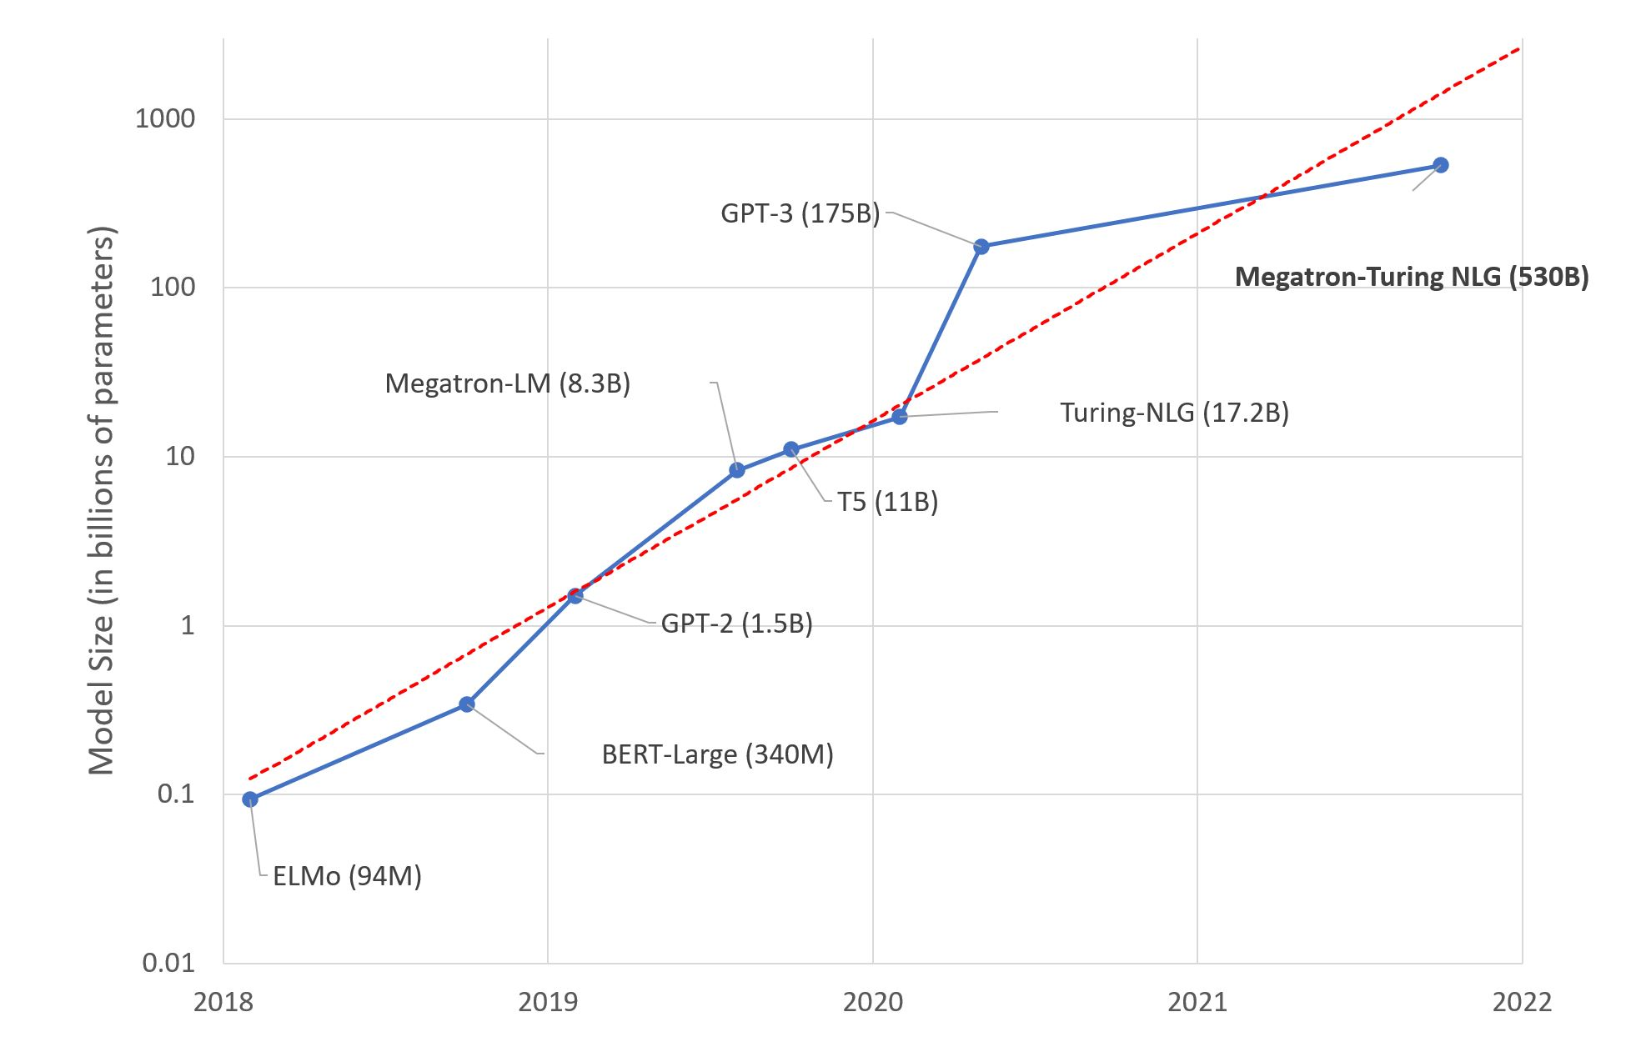
Transfer learning
Prevalent paradigm: transfer learning from PLM
Common way: full fine-tuning(fine-tuning all the model parameters)

Slide 3
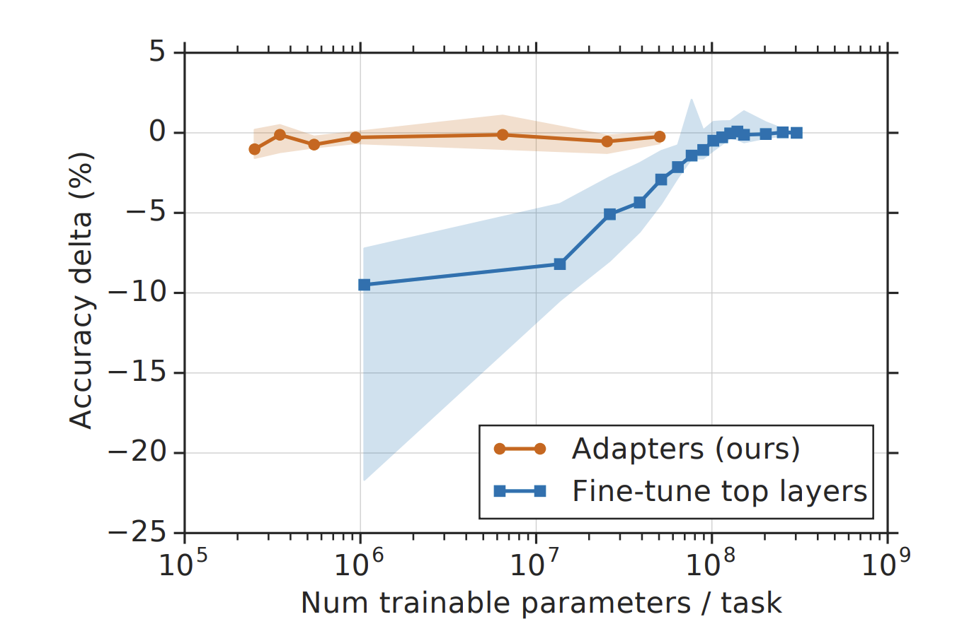
Challenges Introduced by Increasing Model Size
Separate copy of fine-tuned model leads to expensive model serving for every task and domain.
Full fine-tuning requires very careful hyper-parameter tuning during adaptation, and is prone to rapid over-fitting

Slide 4
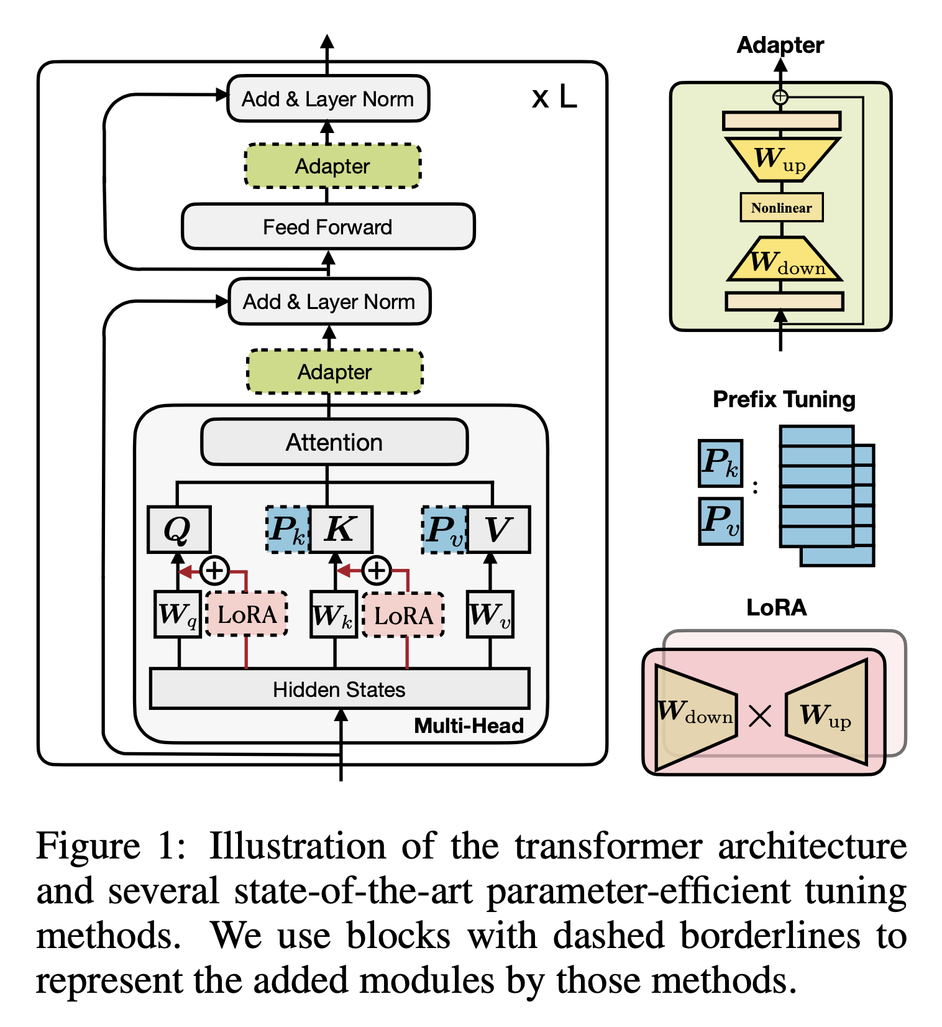
Parameter-Efficient Transfer Learning
Lightweight alternatives: update only a small number of extra parameters while keeping most pretrained parameters frozen.
Prevalent methods:
Adapter tuning
Prefix tuning and prompt tuning
Low-Rank Adaptation (LoRA)
...

Slide 5
Three Unclear Questions
How are these methods connected?
Do these methods share design elements that are essential for their effectiveness, and what are they?
Can the effective ingredients of each method be transferred to others to yield more effective variants?

Slide 6
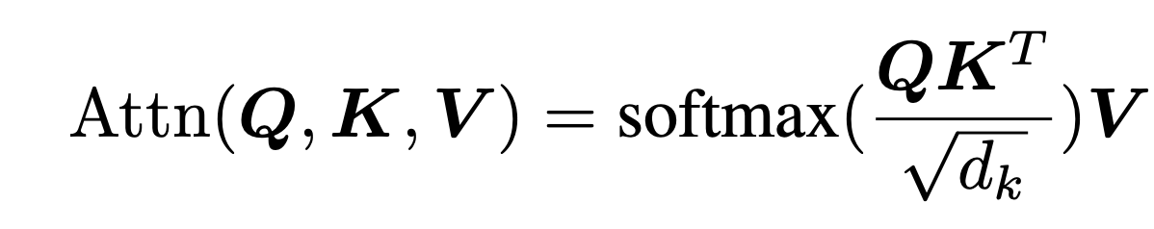
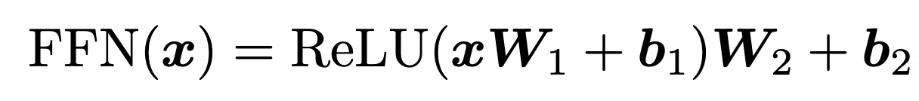
Preliminaries: Transformer
Attention:
Multi-head Attention:
Feed-Forward Network:

Slide 7
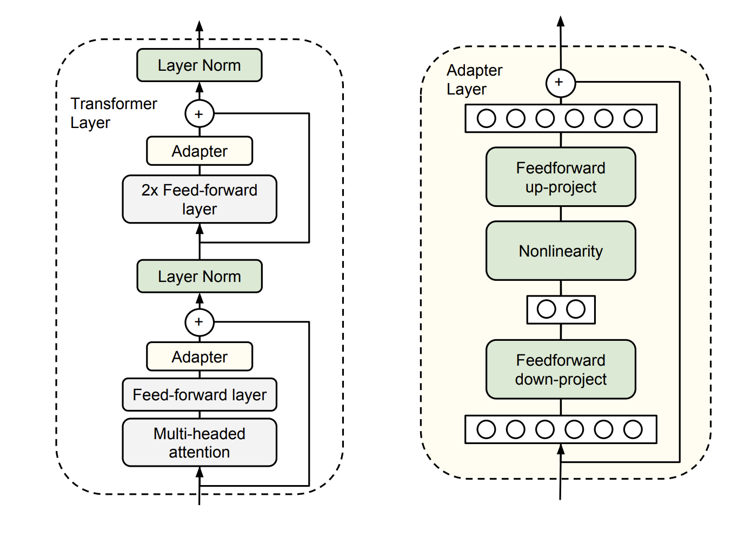
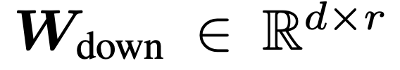
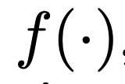
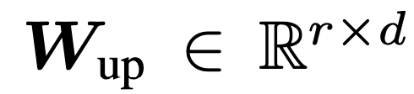
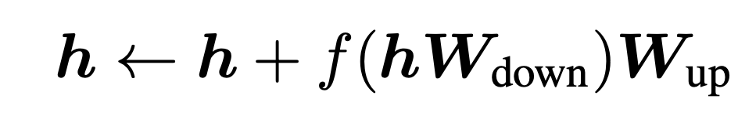
Preliminaries: Adapters
Inserts small modules (adapters) between transformer layers.
Define
a down-projection
A nonlinear activation function
a up-projection
The form of adapters:

Slide 8
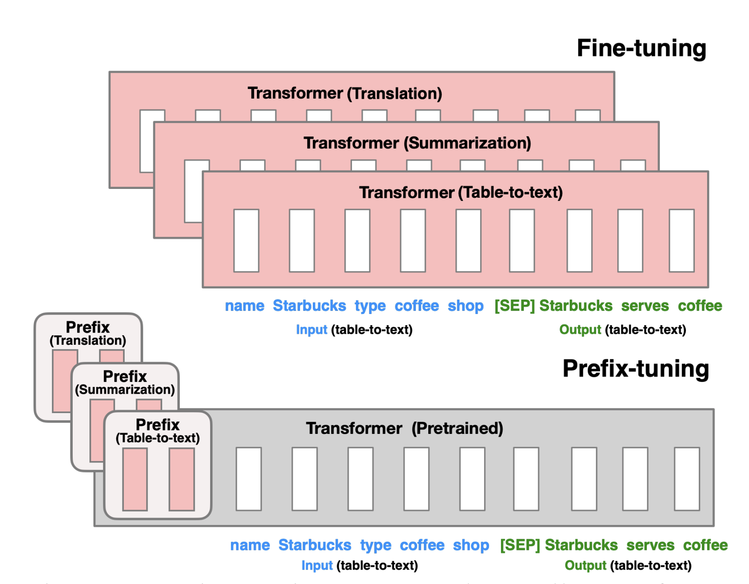
Preliminaries: Prefix-tuning
Prepend tunable prefix vectors to the input sequence( equivalent to prepend to the keys and values of the multi-head attention at every layer)

Slide 9
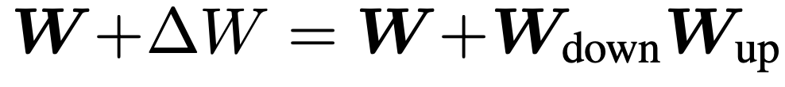
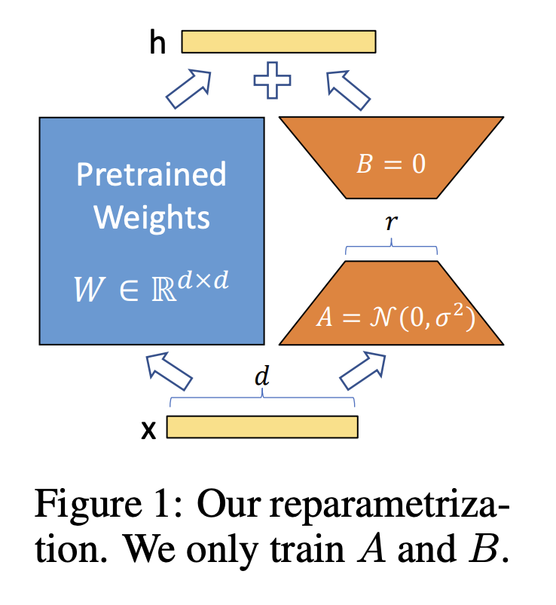
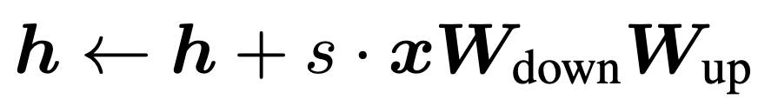
Preliminaries: LoRA
Inject trainable low-rank matrices into transformer layers to approximate the weight updates.
LoRA represents its update with a low-rank decomposition
And the form of LoRA can be described as

Slide 10
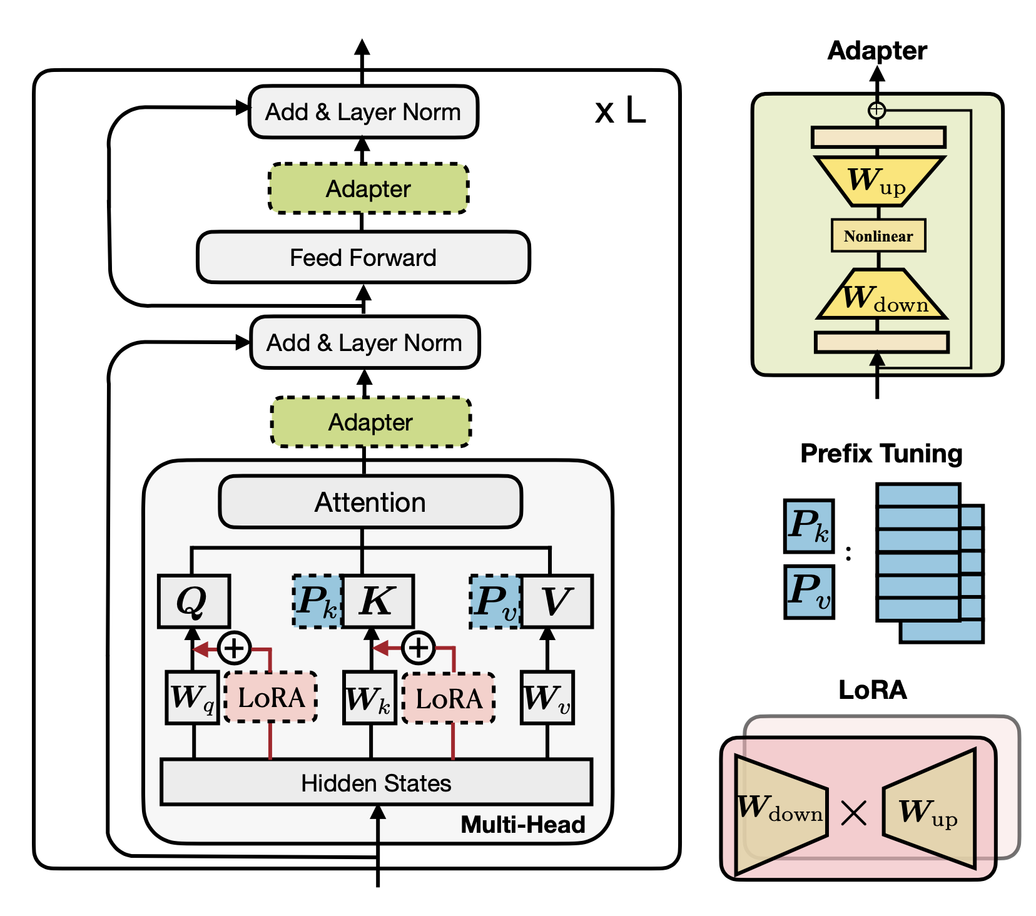
Preliminaries

Slide 11
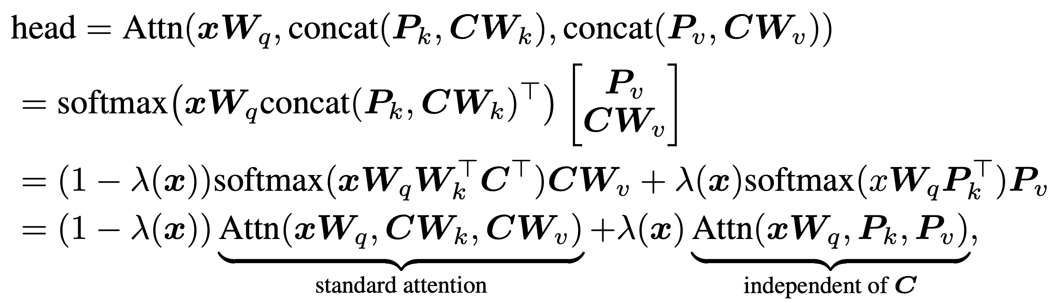
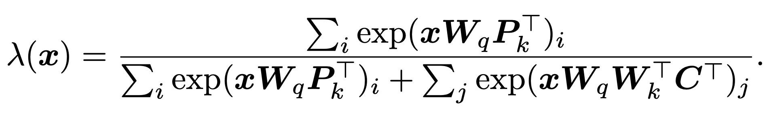
A Unified View: Prefix-tuning
A position-wise modification to the original head attention output h through linear interpolation

Slide 12
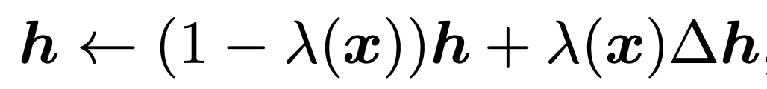
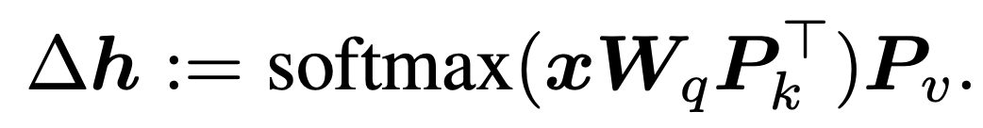
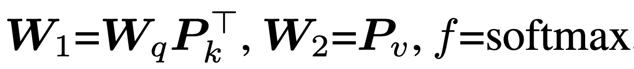
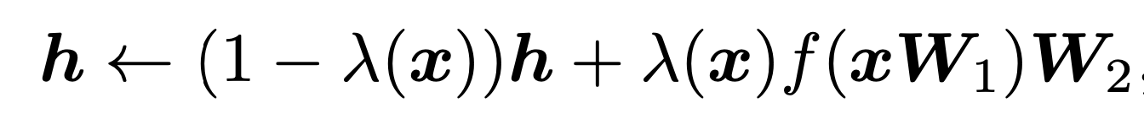
A Unified View: Similarities
Prefix-tuning
Adapter
If we define :
Then:
Similar!

Slide 13
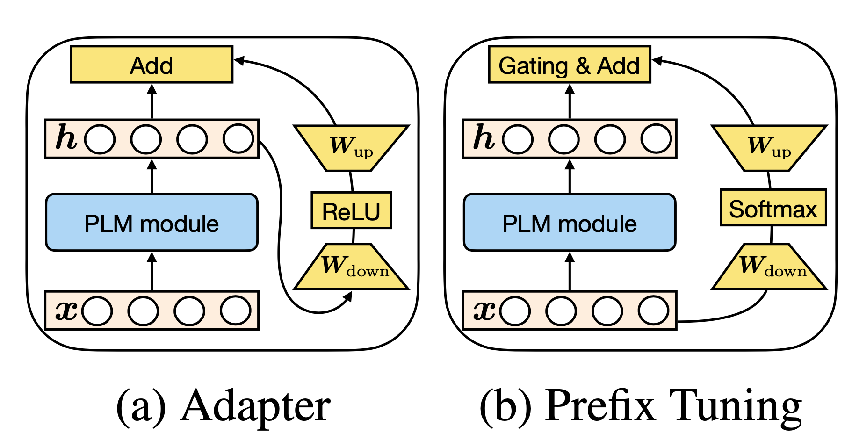
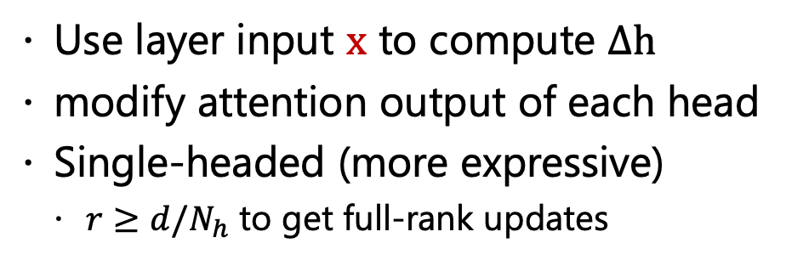
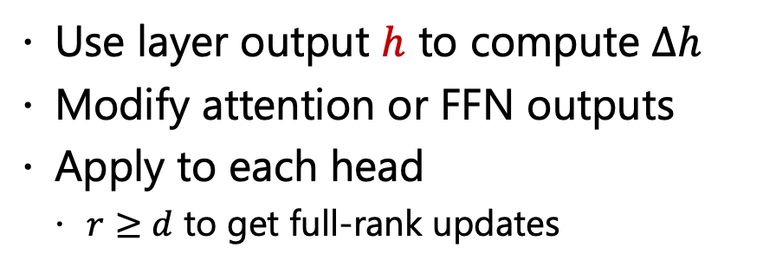
A Unified View: Differences
Adapter
Prefix-tuning
Use layer output $h$ to compute $∆h$
Modify attention or FFN outputs
Apply to each head
$r≥d$ to get full-rank updates
Use layer input $x$ to compute $∆h$
modify attention output of each head
Single-headed (more expressive)
$r≥d/N_{h}$ to get full-rank updates

Slide 14
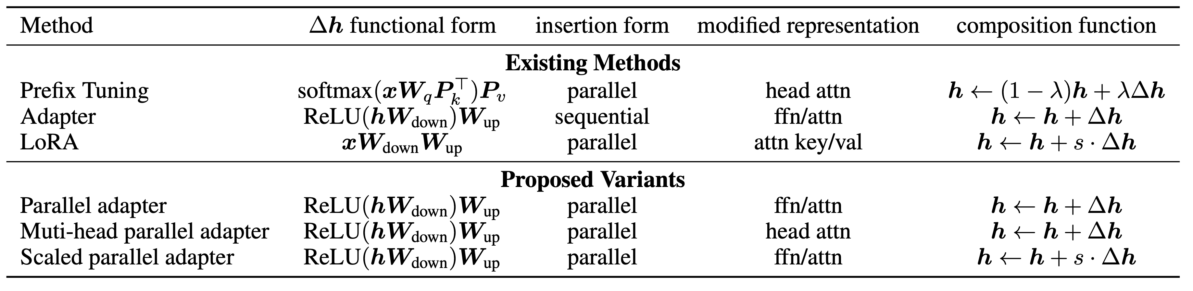
A Unified View
Functional Form: proj_down → nonlinear → proj_up
Insertion Form: parallel/sequential
Modified Representation: which hidden representation is directly modified

Slide 15
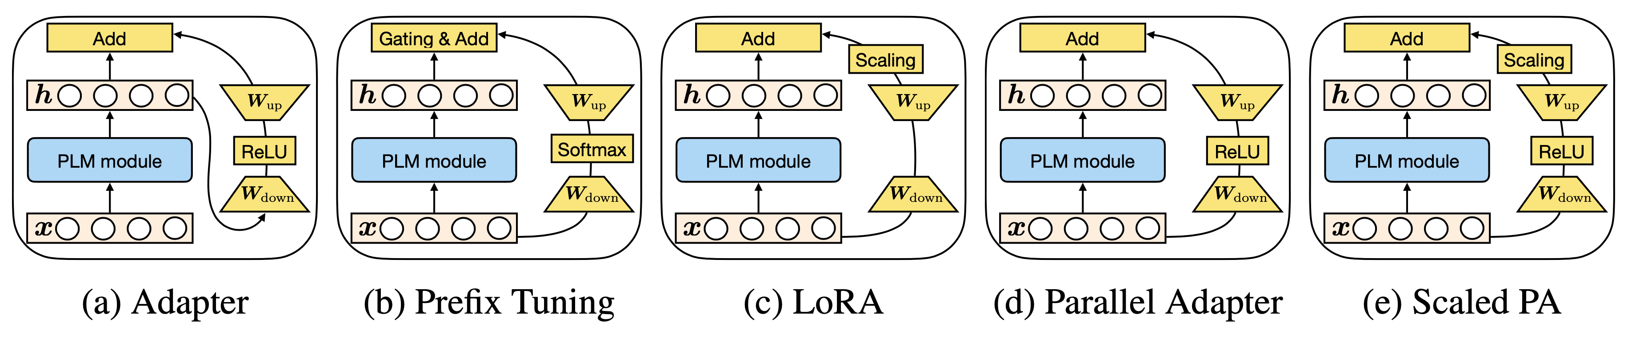
A Unified View: Transferring Design Elements

Slide 16
Experiments
Tasks & Datasets:
Summarization XSum,
Translation WMT 2016
Sentence Representation: MNLI & SST-2
Models
Generation: BART & mBART
Understanding: RoBERTa
Evaluation
Generation: ROUGE 1/2/L & BLEU
Understanding: Accuracy

Slide 17
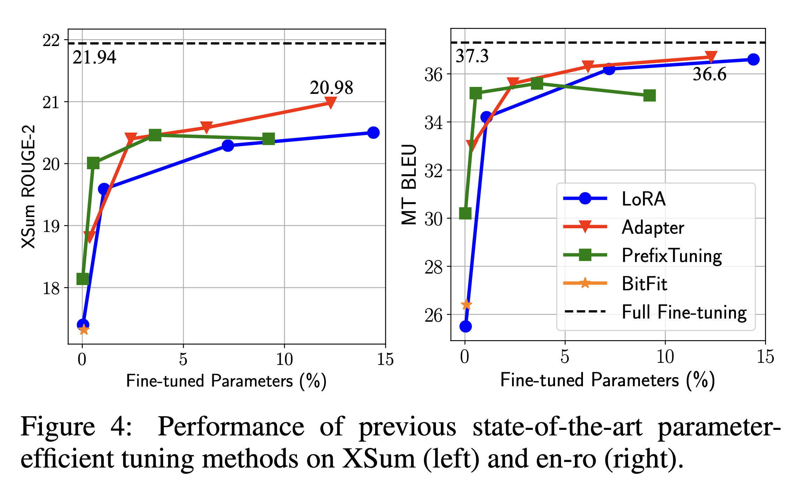
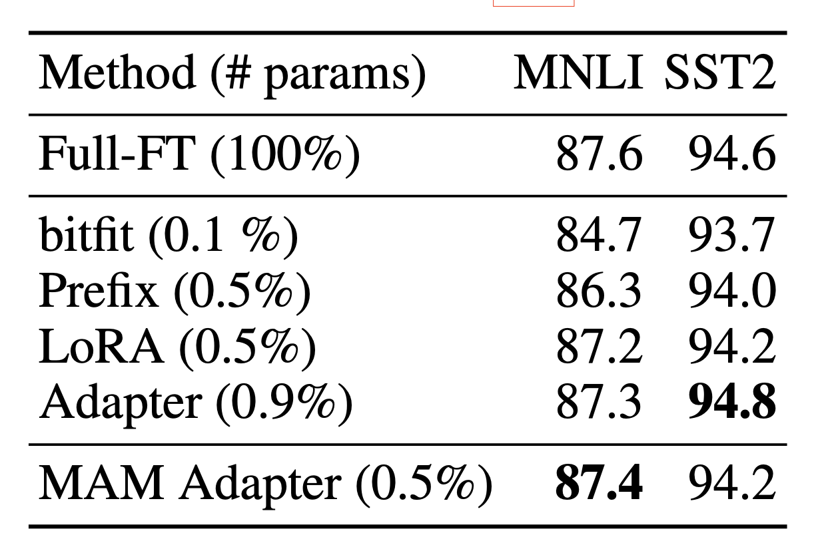
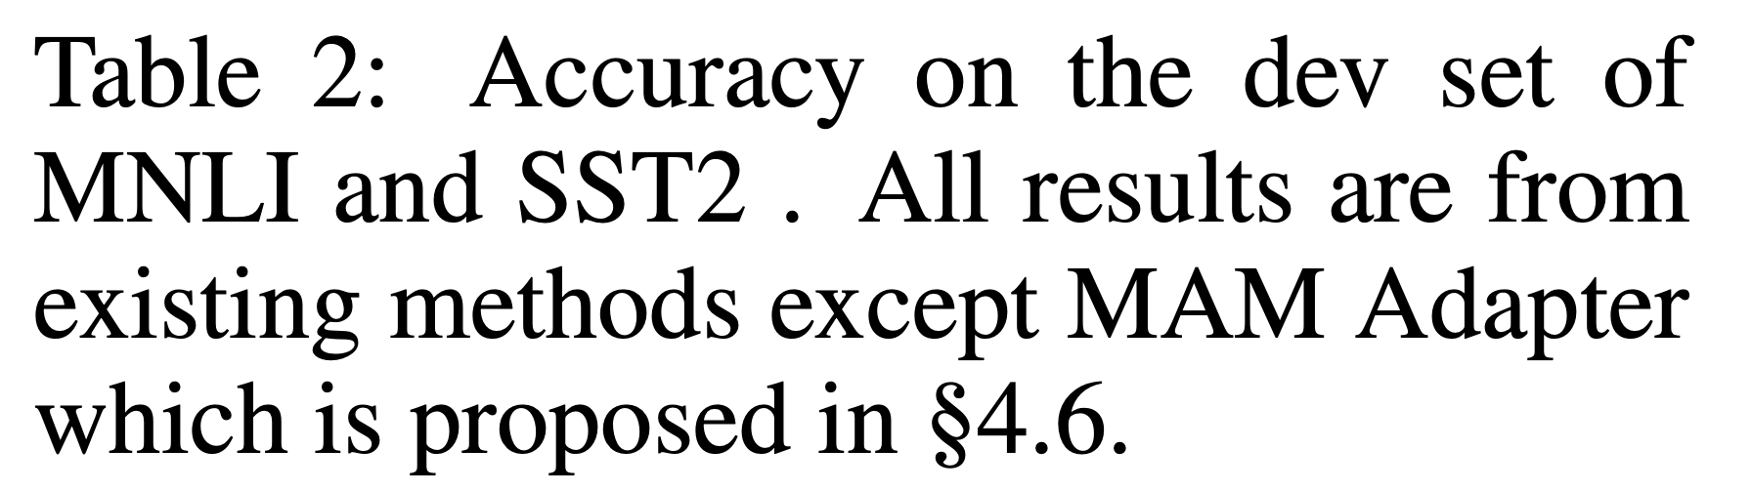
The Results of Existing Methods
MNLI & SST2: competitive by tuning fewer than 1% params
XSum: large gap even though increasing params to >10%

Slide 18
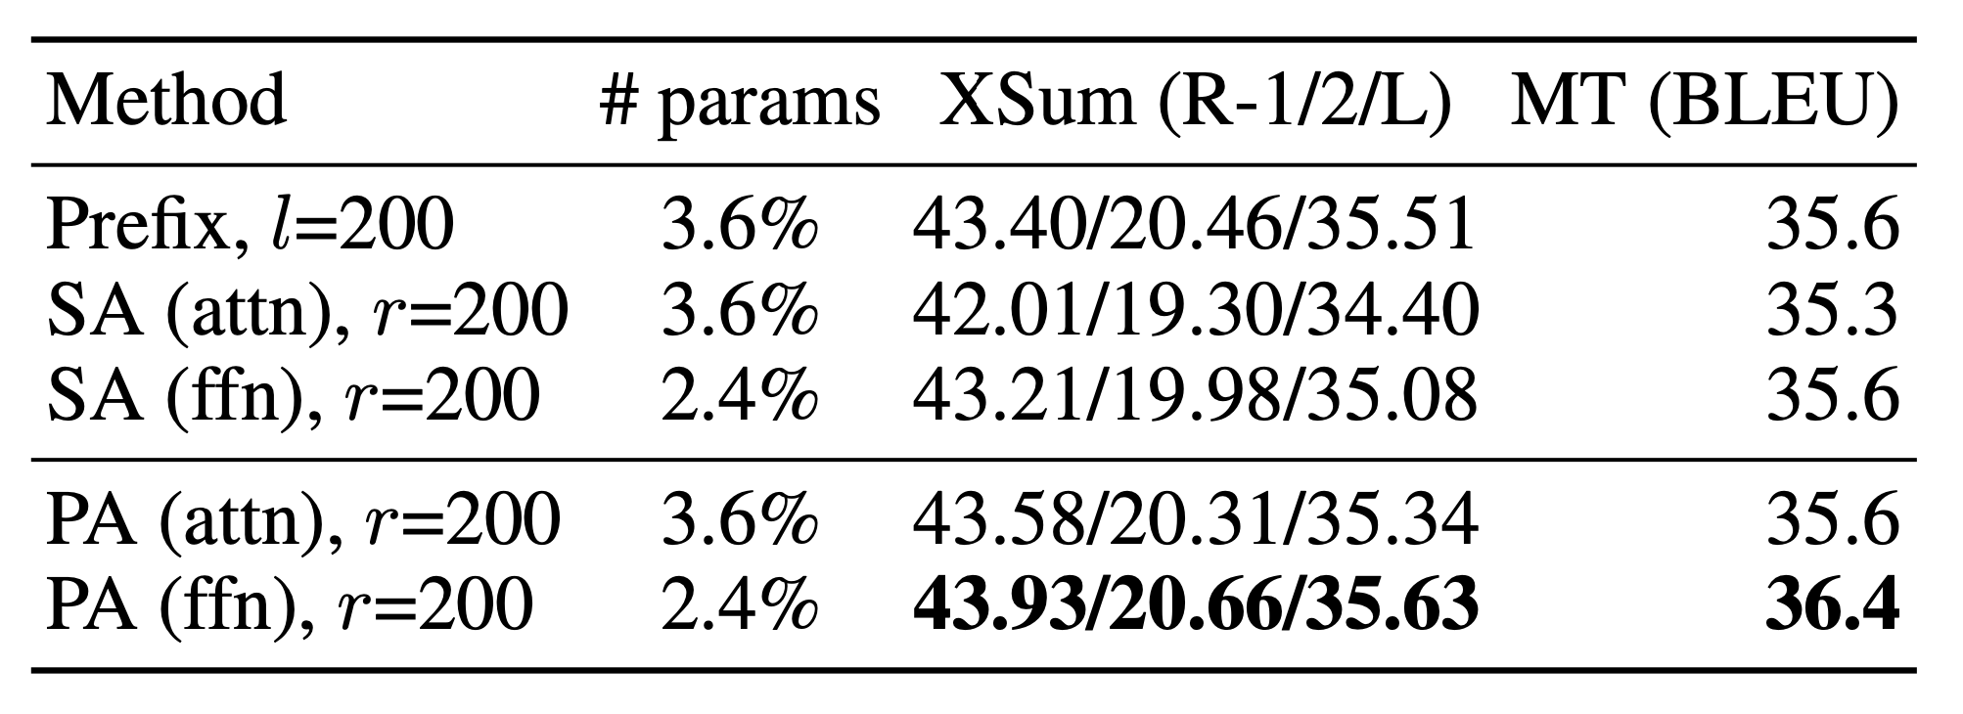
Sequential or Parallel?
The results of parallel adapter (PA) variant to the conventional sequential adapter (SA) over both the attention (att) and FFN
PA(ffn) > PA(attn) > SA(ffn) >SA(attn)
Parallel Adapter (PA) is better

Slide 19
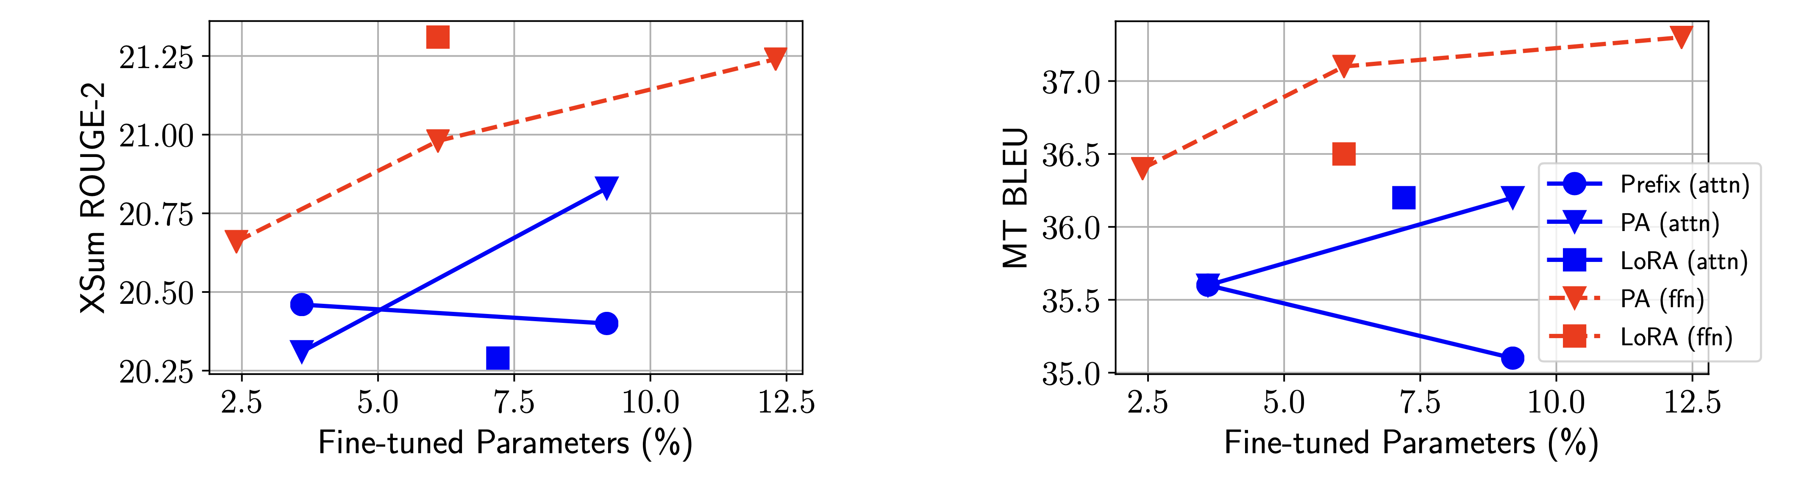
Attention or FFN?
Any method with FFN modification outperforms all the methods with attention modification in all cases
FFN modification can utilize the added parameters more effectively than attention, no matter what the functional form or composition function is.

Slide 20
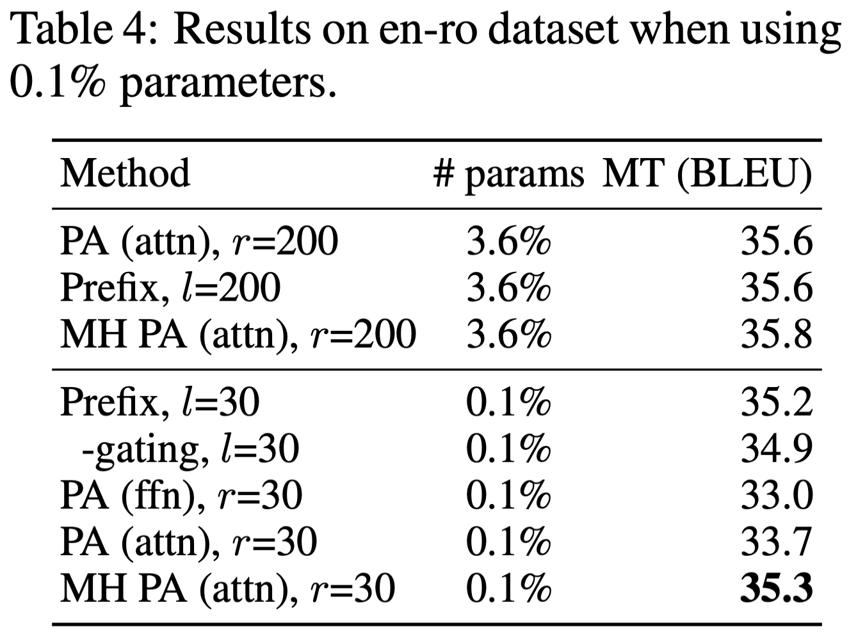
Is the story different when we use 0.1% parameters?
The multi-head methods – prefix tuning and MH PA (attn) – outperform all others

Slide 21
Attention or FFN?
Modifying head attention shows the best results when the parameter budget is very small, while the FFN can better utilize modification at larger capacities.
It may be effective to allocate a larger parameter budget to FFN modification instead of treating attention and FFN. (equally as in the adapter paper)

Slide 22
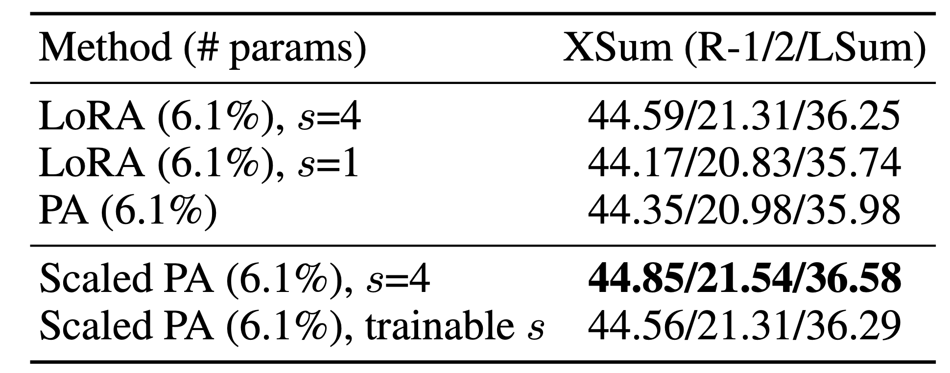
Which Composition Function?
LoRA with a tuned scaling factor (s = 4) performs better than parallel adapter. However, the advantage disappears if we remove the scaling by setting s = 1
The scaling composition function is better than the vanilla additive one while being easily applicable.

Slide 23
Three Findings
Scaled parallel adapter is the best variant to modify FFN
FFN can better utilize modification at larger capacities
Modifying head attentions like prefix tuning can achieve strong performance with only 0.1% parameters

Slide 24
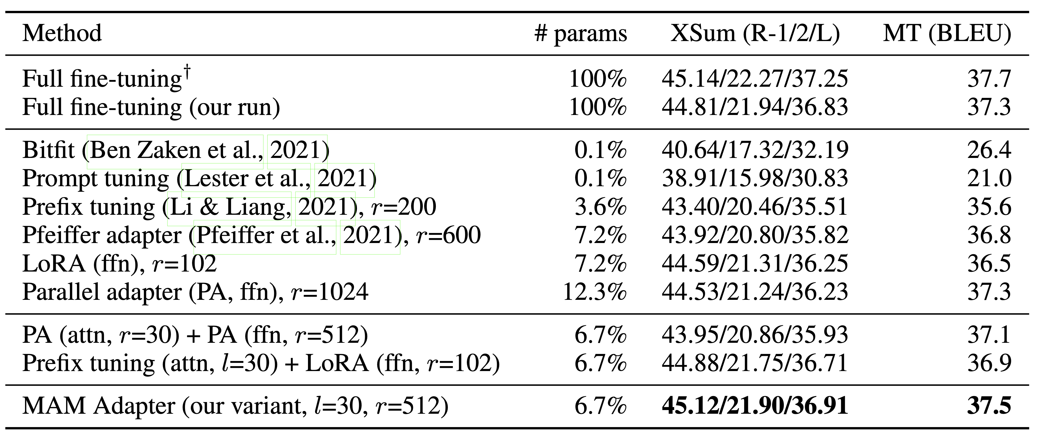
Final Design: Mix-And-Match(MAM) adapter
A small bottleneck dimension at the attention sub-layers
More parameter budgets to modify FFN with scaled parallel adapter

Slide 25
Thank you

